Slide 1


Graduation Project ONL4-DAT1-G3

Slide 2
About the Project
Graduation Project ONL4-DAT1-G3
E-COMMERCE SALES & CUSTOMER BEHAVIOR ANALYSIS

Slide 3
About the Project
Graduation project ONL4-DAT1-G3
UNDER SUPERVISION OF:
PROF. DR. AHMED ISMAIL
GROUP #2
Bola Mourise Amany Aly Al Zahraa Samir LEADER: Asmaa Ismail

Slide 4
Introduction
Project Overview
Analyze customer purchasing behavior and sales performance.
Data collected from United Kingdom, Germany, Canada, and Australia.
Covers transactions from 2023–2024.
Includes customer demographics: Age, Gender, Income Level, and Segmentation.

Slide 5
Introduction
Business questions
Q1: Sales & The 2024 Decline: Why did our sales drop drastically from 2023 to 2024, and what is the real cause?
Q2: Marketing Targeting: Which specific age group should we target with our marketing budget to maximize sales?
Q3: Shipping Performance: What is our most used shipping method, and where are the delays happening?

Slide 6
Introduction
High Data Volume Challenge:
Discovery: The dataset was exceptionally large, containing 294,438 rows of transactional records, which required optimized processing to avoid system lag during analysis.
Action Taken: Utilized Power Query's efficient indexing and data loading capabilities to handle the massive volume smoothly, ensuring performance stability while building visualizations.

Slide 7
294,438 Rows

Slide 8


Slide 9
Introduction
Objectives
Time-Series Analysis: Evaluate sales trends, seasonality, and diagnose the 2023-2024 revenue drop using YoY metrics.
Customer Segmentation: Identify high-value segments (New, Regular, Premium) based on purchase frequency and total spend.
Demographic & Geographic Mapping: Analyze how age, gender, income, and location drive purchasing behavior.
Actionable Recommendations: Deliver interactive dashboards to optimize marketing campaigns and business strategies.

Slide 10
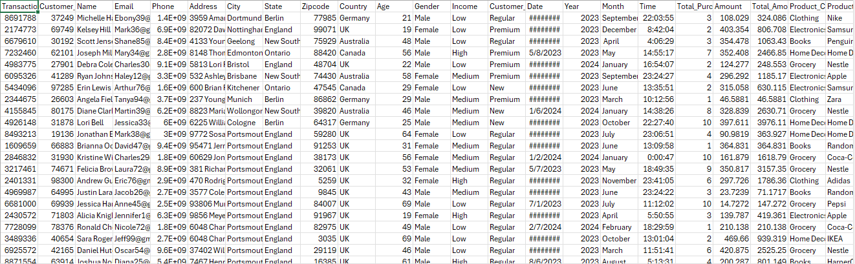
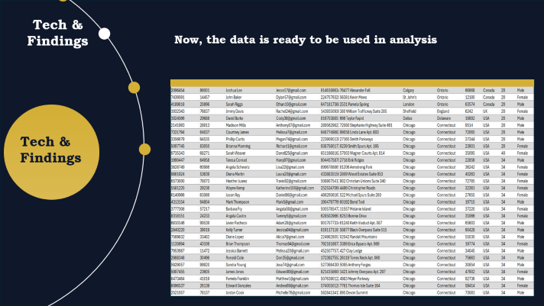
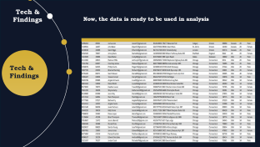
Data Cleaning
Using Excel-Power Query to clean, transform, and handle data anomalies, replacing errors to ensure data integrity and readiness for analysis.

Slide 11
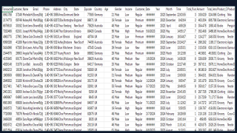
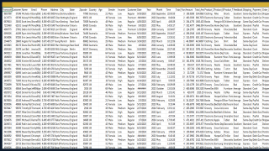

Slide 12
Introduction
Extensive Data Gaps & Missing Values:
Discovery: Discovered widespread missing data (blanks) across multiple critical columns. Most were found in the Date, Year, and Month columns, as well as the purchases (Order Q) and Total Amount columns.
Action Taken: Applied advanced logical formulas to reconstruct the missing timeline elements. Similarly, blank fields in order counts and total amounts were cross-calculated and filled using mathematical dependencies to achieve 100% data completeness and accuracy.

Slide 13
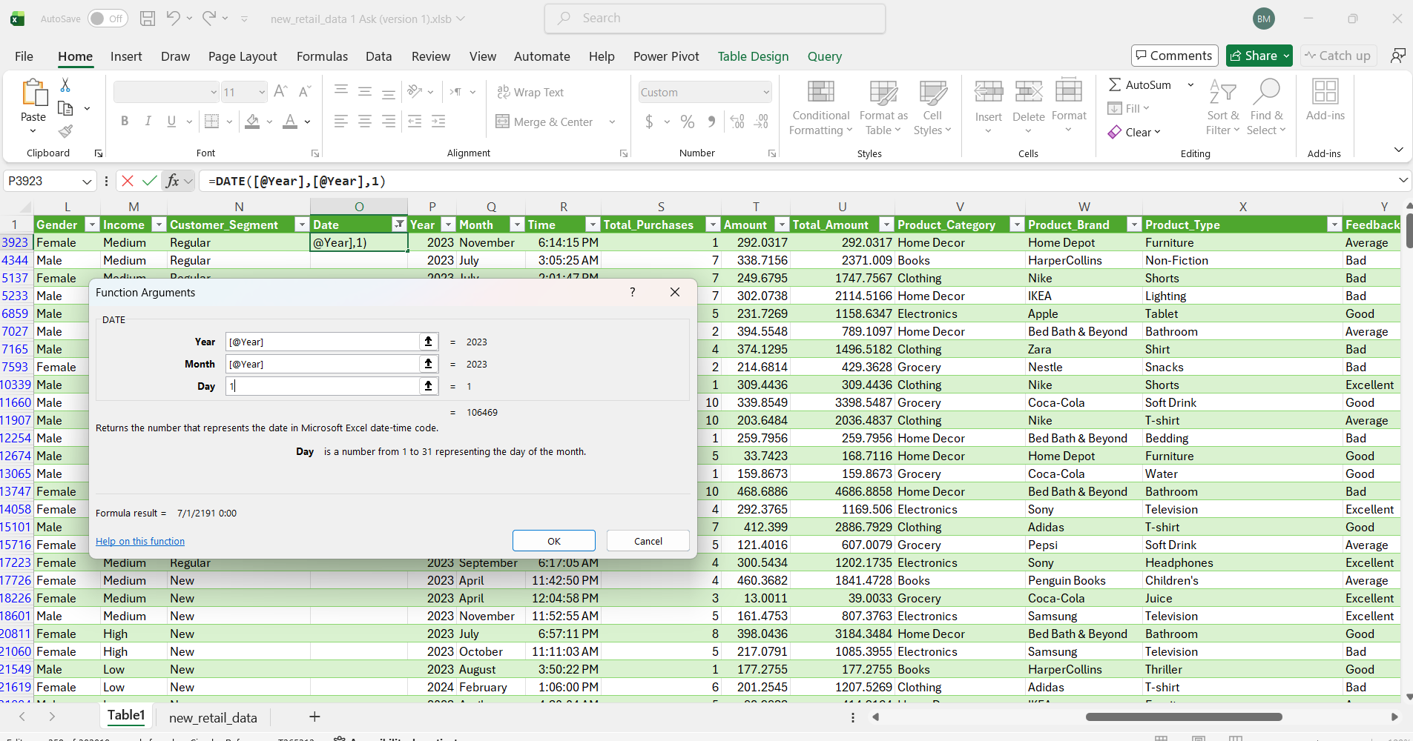
Introduction

Slide 14
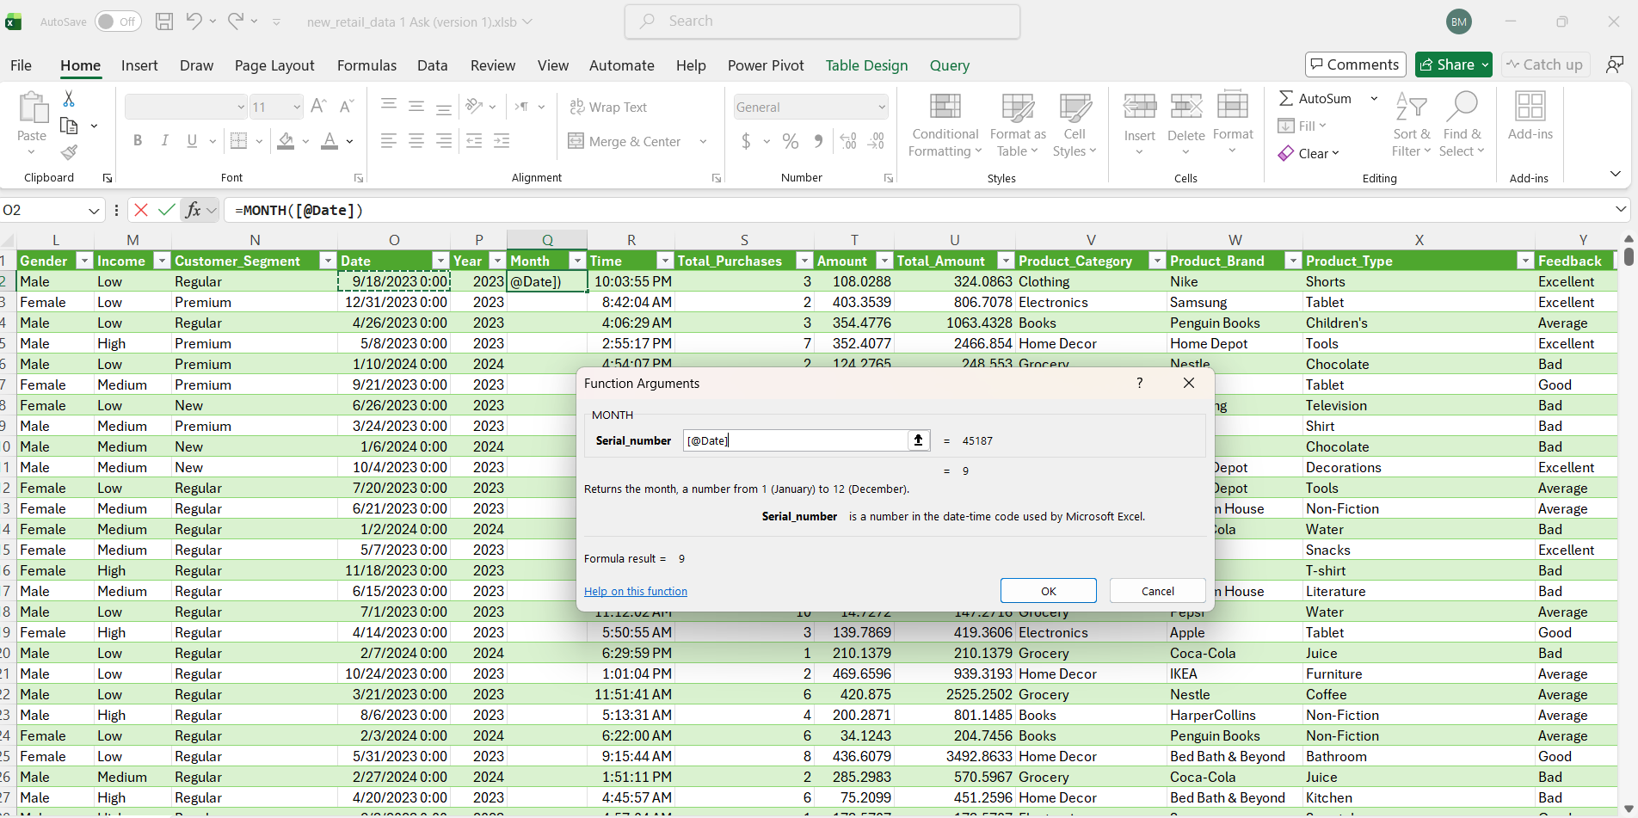
Introduction

Slide 15
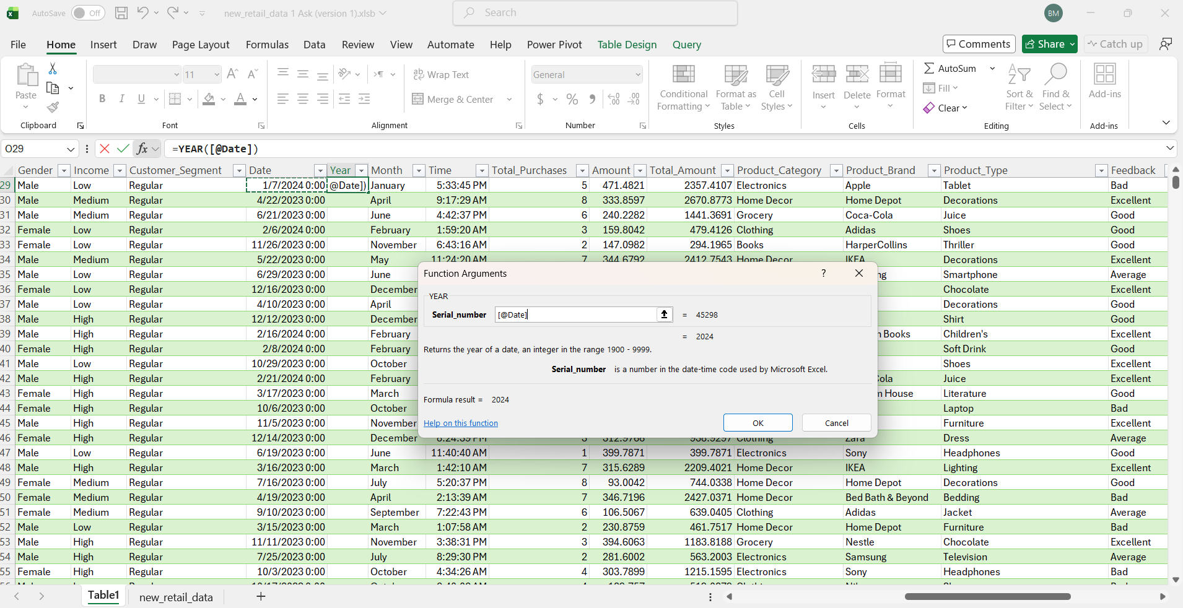
Introduction

Slide 16
Introduction
Absence of Profit Margin Data:
Discovery: The original dataset lacked a dedicated column for profit margins.
Action Taken: Established a calculated parameter assuming an estimated profit margin of 20% of Total Amount.

Slide 17
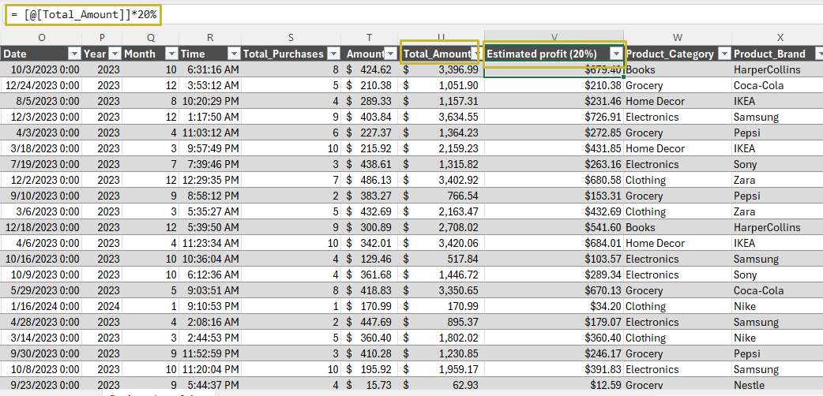
Introduction

Slide 18
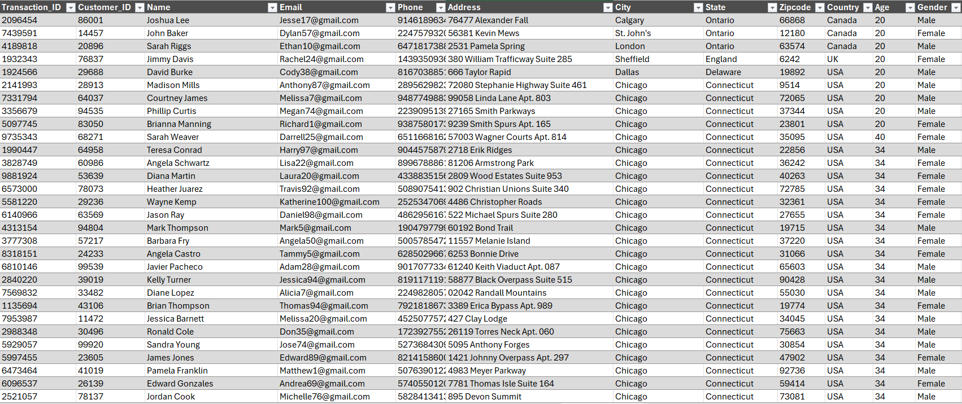
Data Cleaning
Now, the data is ready to be used in analysis

Slide 20
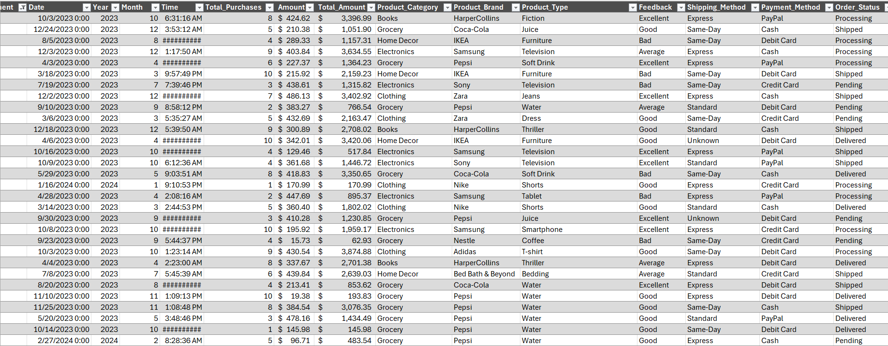

Slide 21



Visualizations & Insights
Dashboards

Slide 22
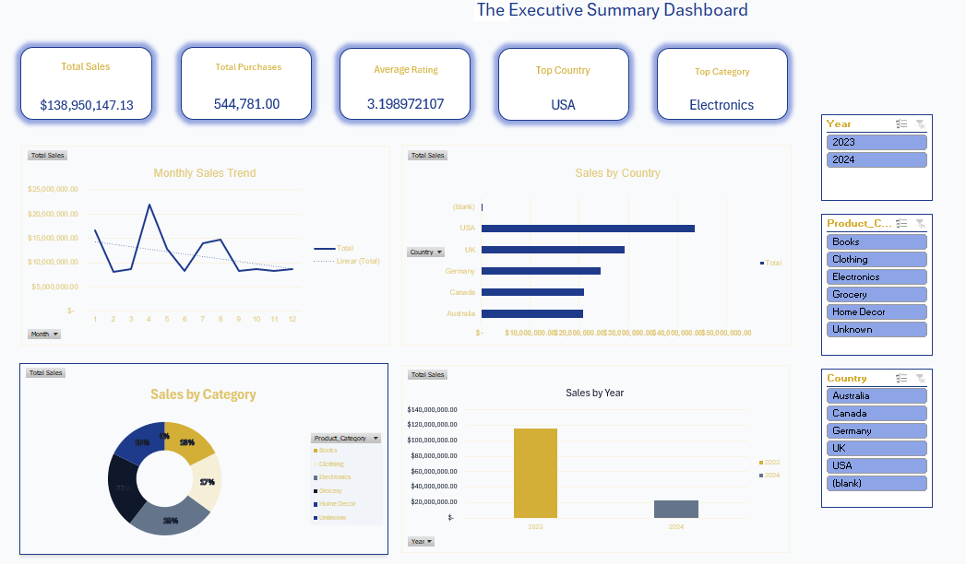

Visualizations & Insights

Slide 23
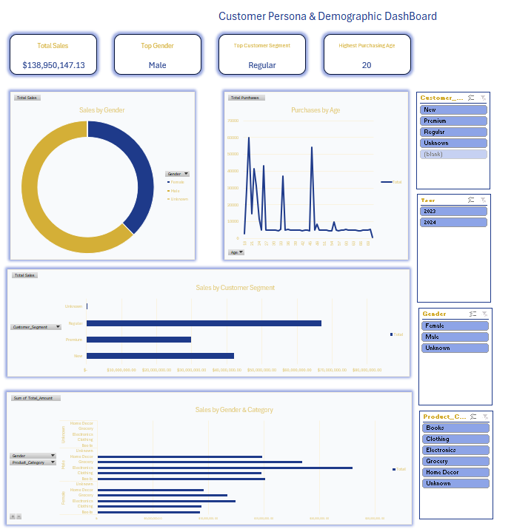
Visualizations & Insights

Slide 24
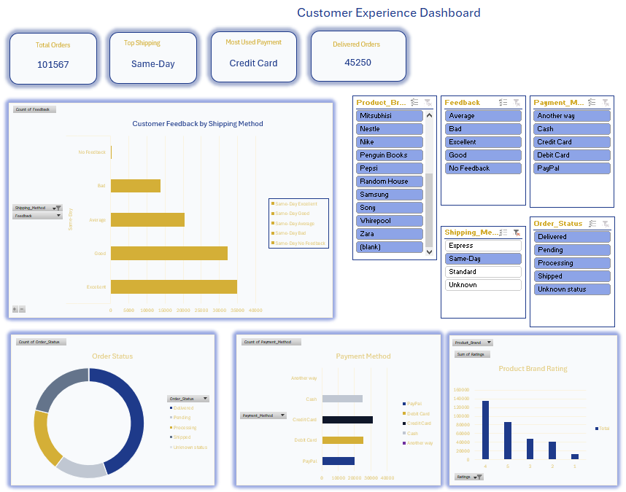
Visualizations & Insights

Slide 25
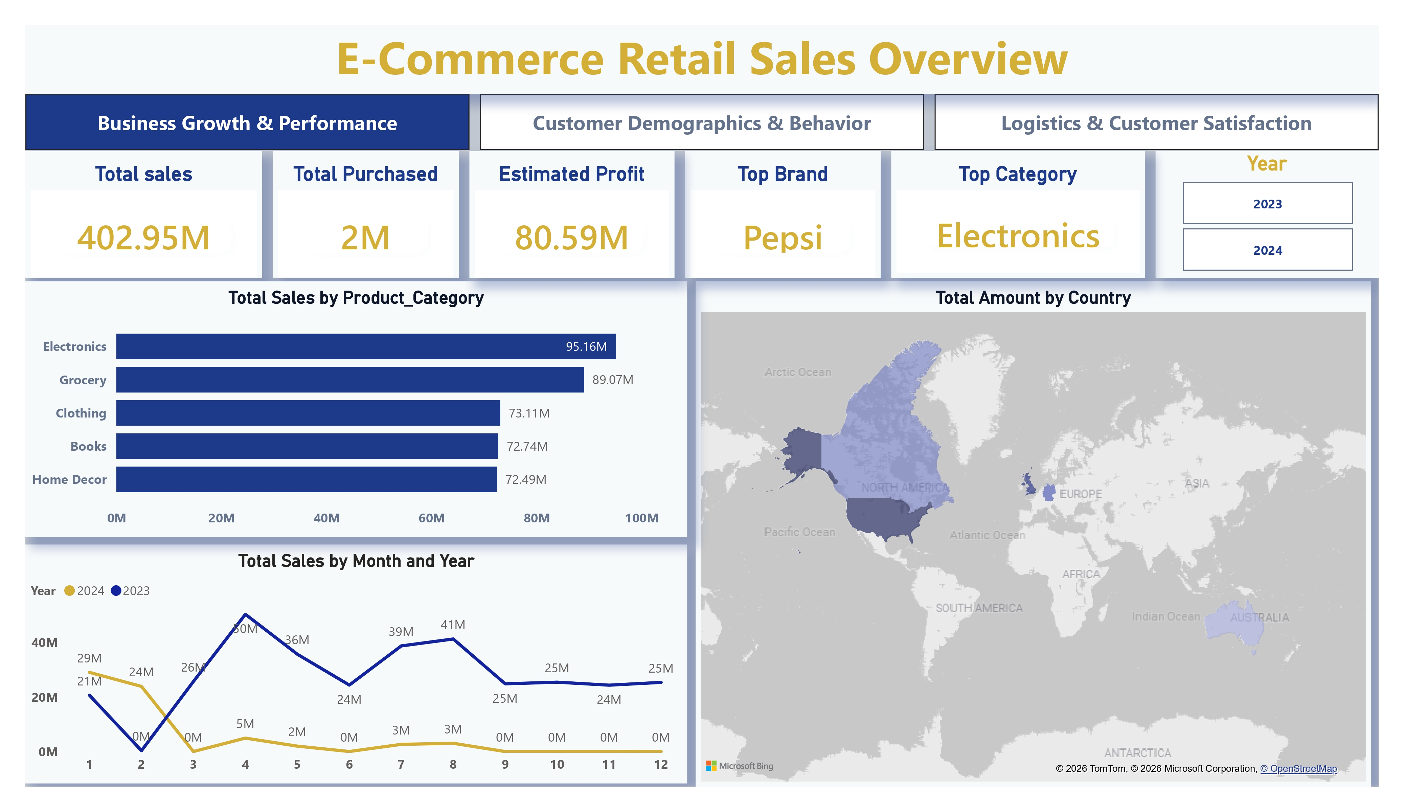

Visualizations & Insights

Slide 26
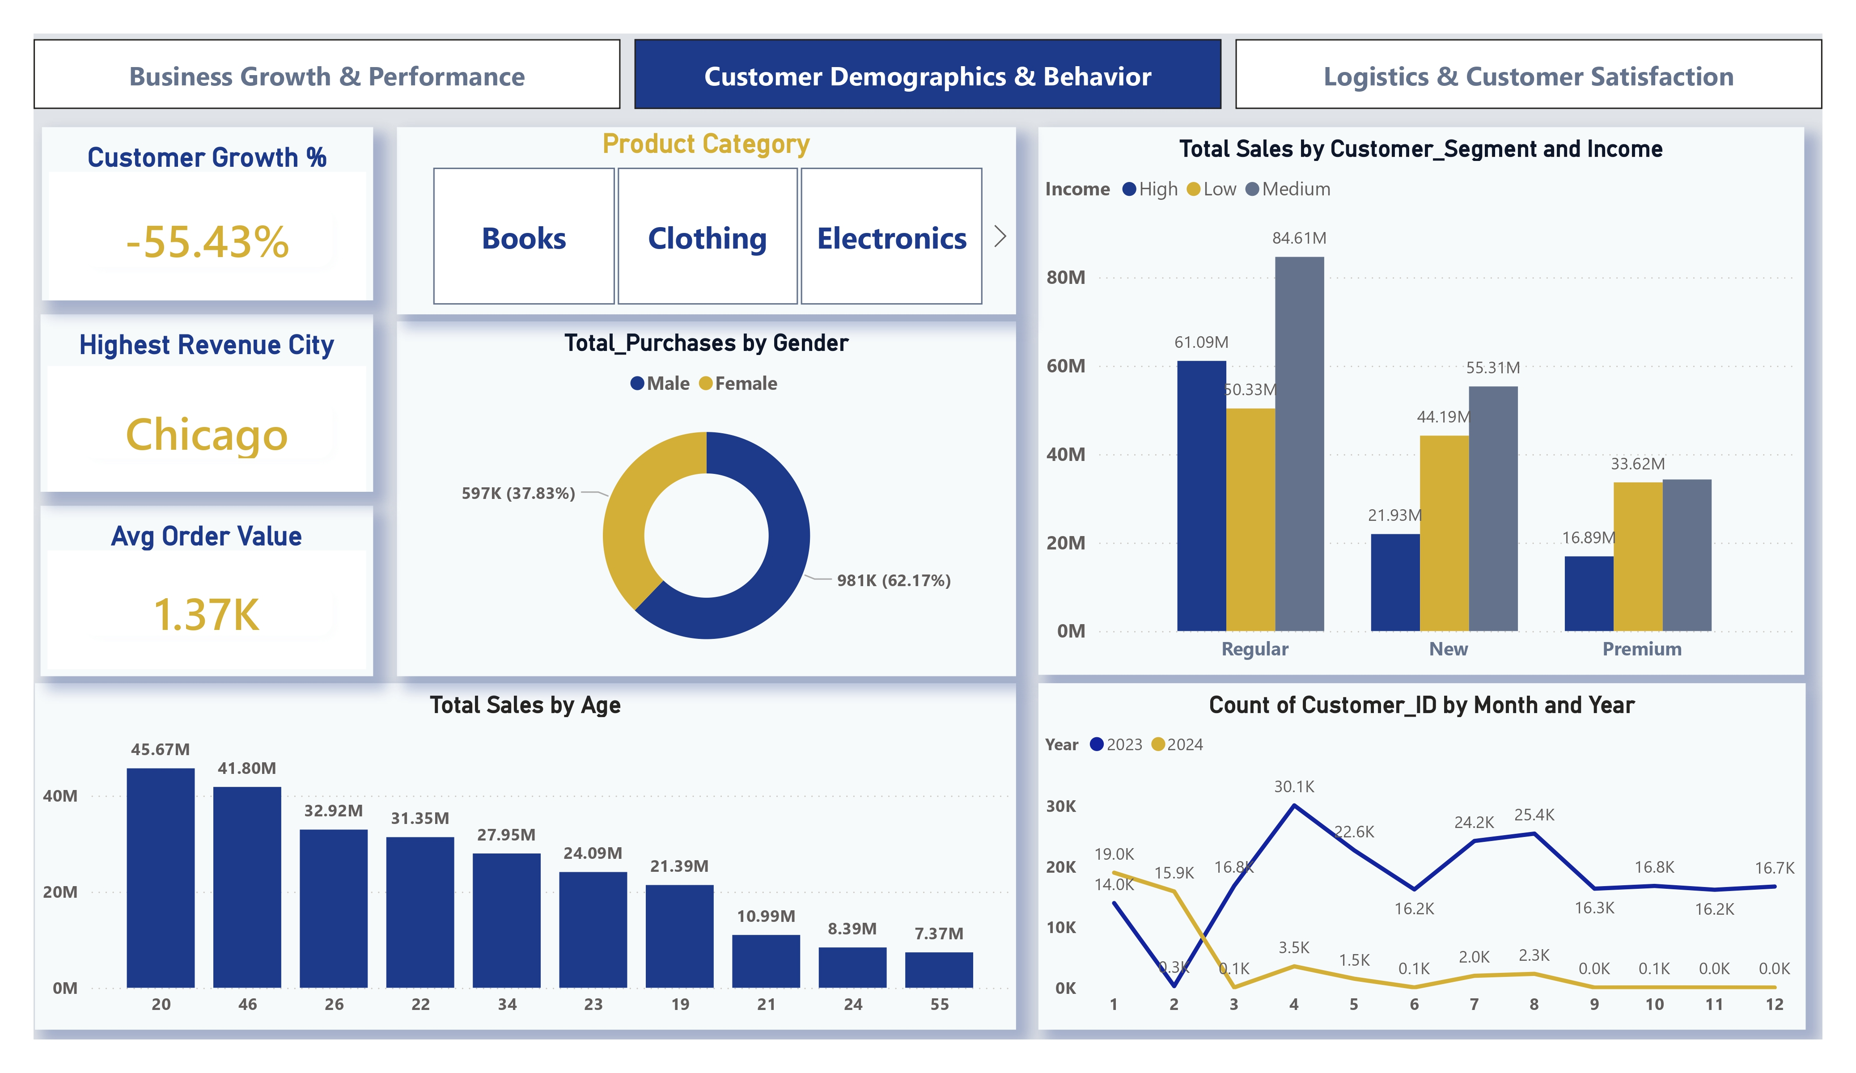
Visualizations & Insights

Slide 27
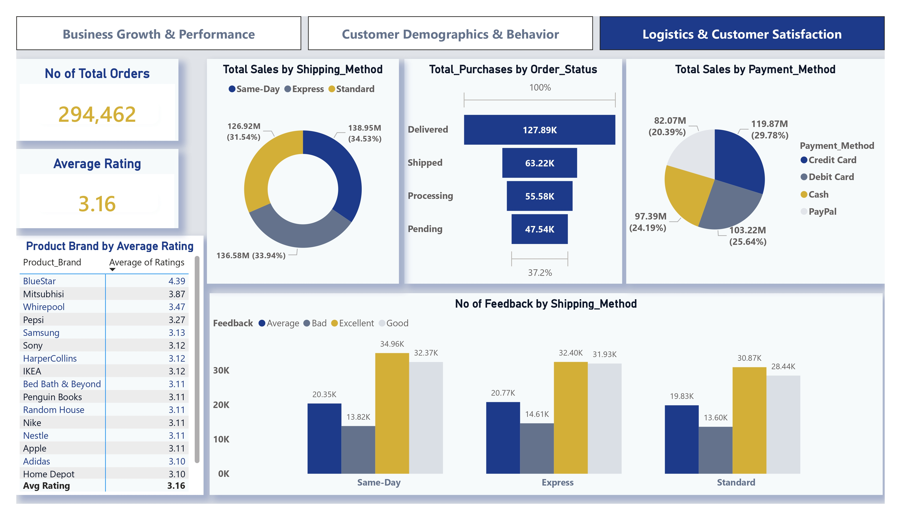
Visualizations & Insights

Slide 28
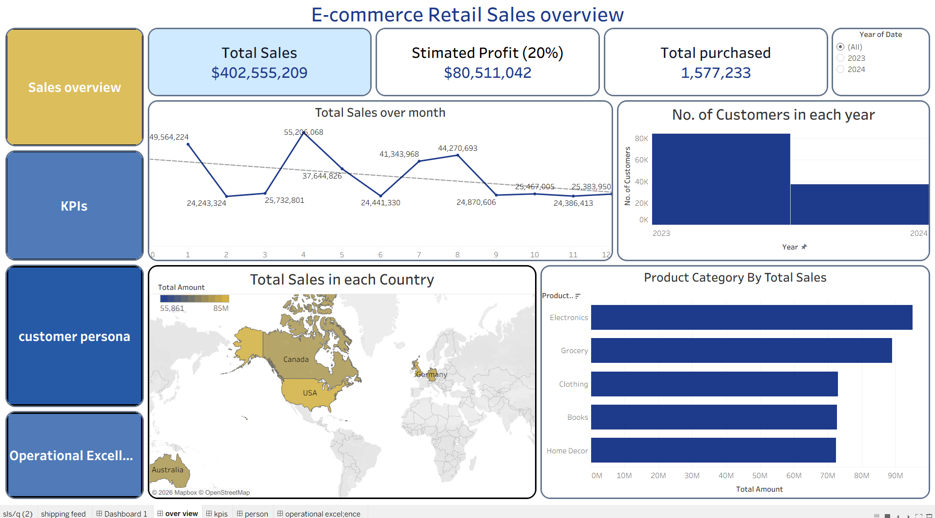

Visualizations & Insights

Slide 29
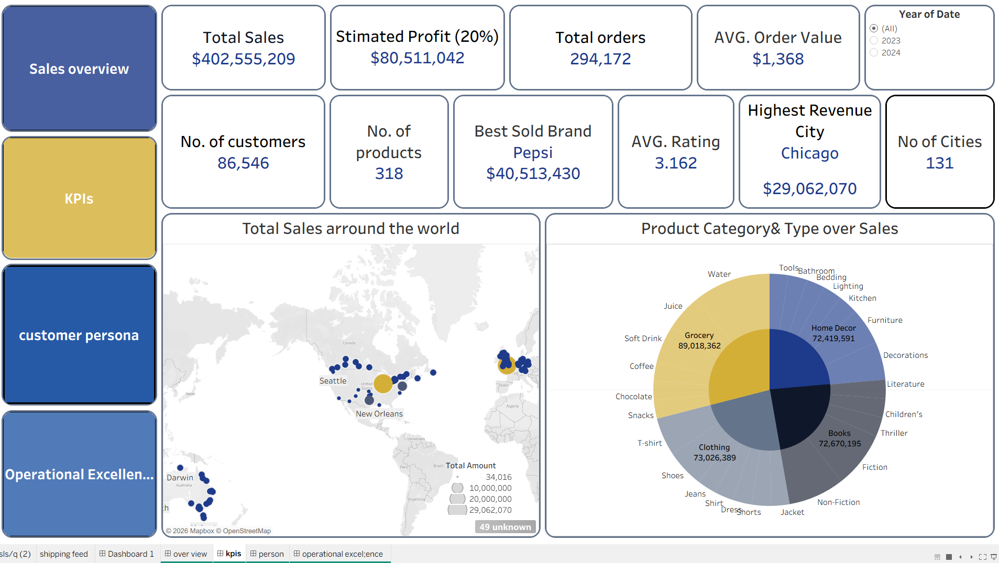
Visualizations & Insights

Slide 30
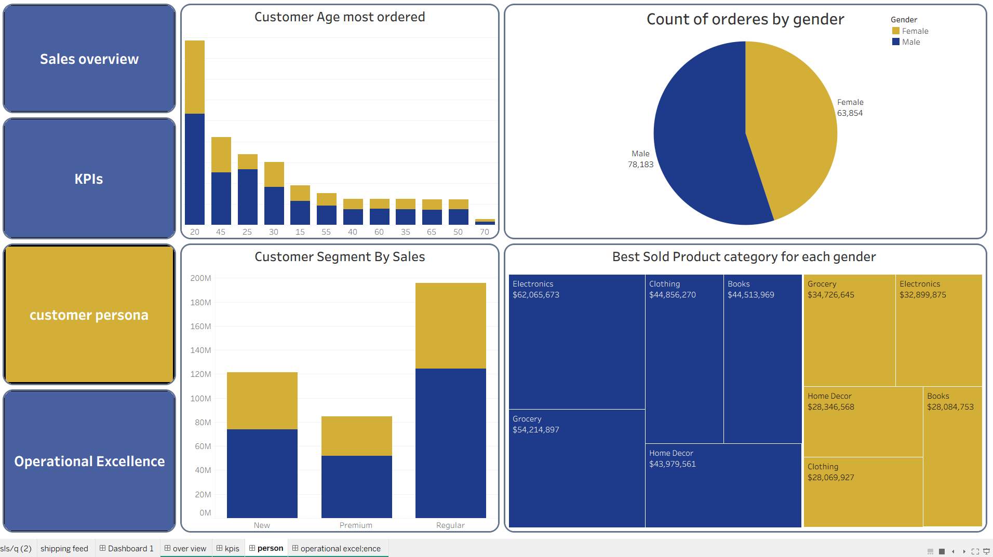
Visualizations & Insights

Slide 31
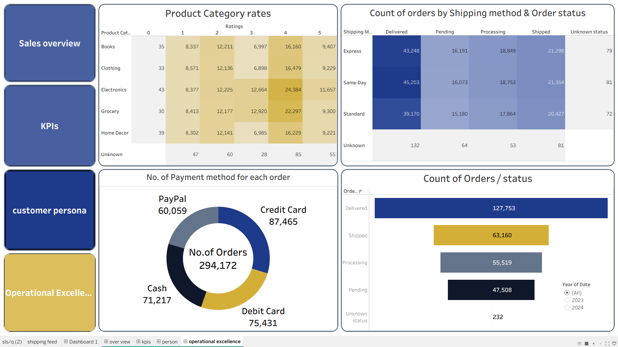
Visualizations & Insights

Slide 32
Insights & Recommendations
“ Based on the data insights, we are presenting 4 actionable recommendations to the business owner to secure data integrity, minimize operational bottlenecks, and maximize profitability. ”

Slide 33
Insights & Recommendations
Sales Performance & Temporal Gaps
Total Amount in:
2023
$366M
2024
$66M
“ Sudden, sharp revenue drop in 2024 compared to 2023, causing cash-flow instability. ”

Slide 34
Strategic Recommendations for the Business Owner
1. Data Governance & Reporting
The Advice: Implement a Real-Time Data Sync and fix Customer Relationship Management (CRM) entity resolution.
The Reason: Your 2024 revenue looks like it dropped by 80%, but our technical audit proved it’s just incomplete data collection. Fixing this prevents you from making panicked business decisions based on lagging or distorted reports.
Recommendations

Slide 35
Insights & Recommendations
Customer Persona & Demographic Analysis
Total Customers
Males: 78.2K
Females: 63.8K Unknown: 310
“ Low sales from older demographics >50 ”
Core Segment Young adults aged 20 – 45

Slide 36
Recommendations
2. Marketing & Revenue Optimization
The Advice: Allocate 70% of your ad budget to target young adults (aged 20–45) with Medium/High incomes in the USA.
The Reason: This demographic is your core revenue engine. Shifting away from generalized campaigns will instantly maximize your Return on Ad Spend (ROAS).

Slide 37
Insights & Recommendations
Customer Persona & Demographic Analysis
"Regular" segment drives the bulk of sales.
Premium: $85M
Regular: $196M
“ low revenue contribution from the "Premium" segment. ”

Slide 38
Recommendations
3. Customer Retention Strategy
The Advice: Launch an exclusive VIP / Premium Loyalty Program to convert "Regular" buyers into "Premium" ones.
The Reason: The Premium segment yields your highest Customer Lifetime Value (CLV). Retaining these high-value assets is 5 times cheaper than acquiring new ones.

Slide 39
Insights & Recommendations
Operational Excellence & Fulfillment
Total Orders:
294,462
“ The Problem:
High backlog of orders stuck in Shipped, Processing, and Pending statuses, indicating shipping bottlenecks. ”
Order Status: Shipped 63.2K Processing 55.5K
Delivered 127.8K
2023 83%
2024 16%

Slide 40
Insights & Recommendations
4. Supply Chain & Logistics Overhaul
The Advice: Audit and review current shipping vendors to accelerate order fulfillment.
The Reason: A massive backlog of orders is currently stuck in "Shipped" and "Processing" statuses. Clearing this bottleneck will reduce order cancellations and boost customer satisfaction.

Slide 41
Questions ?

Slide 42
THE END
Making Of Project

Slide 43
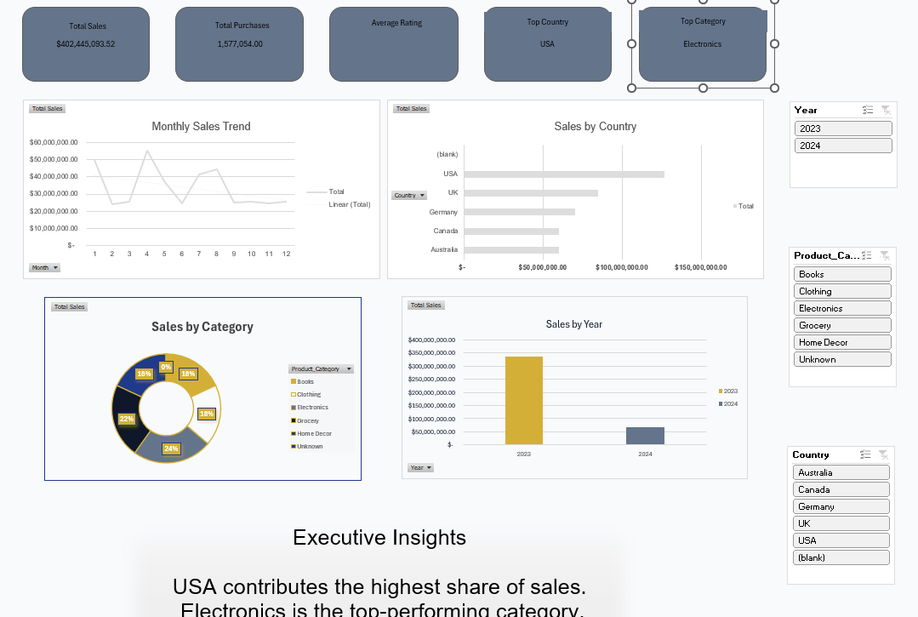
Backstage

Slide 44
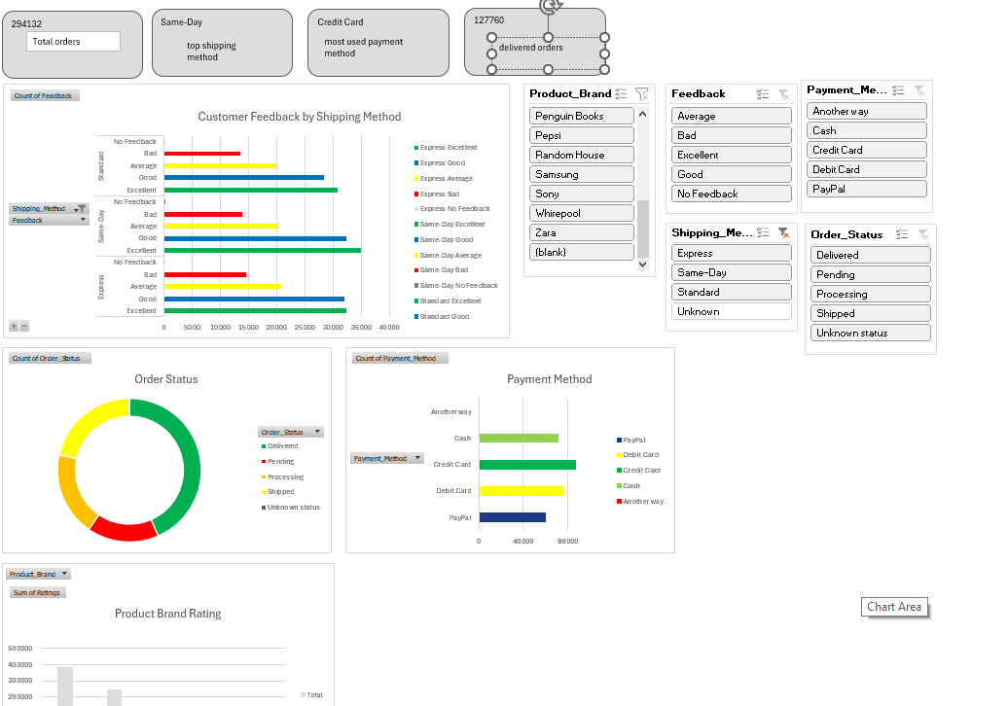

Slide 45
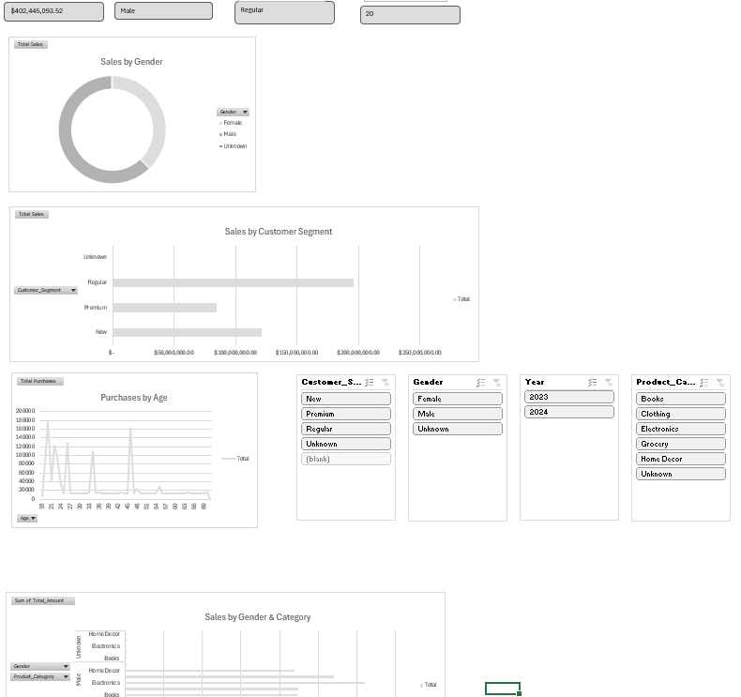

Slide 46
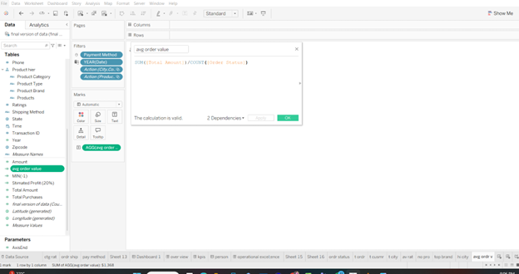

Slide 47
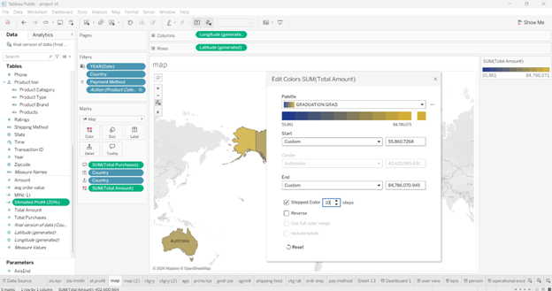

Slide 48
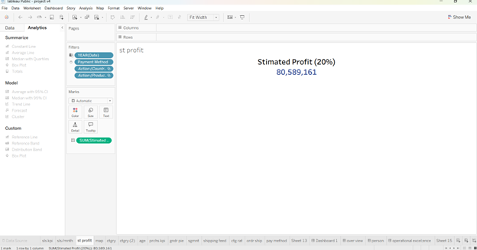

Slide 49
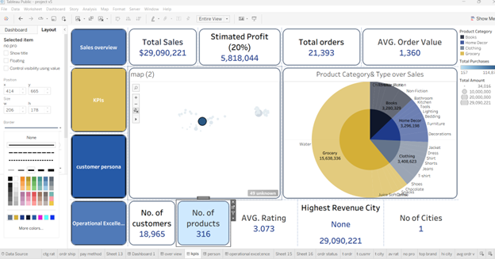

Slide 50
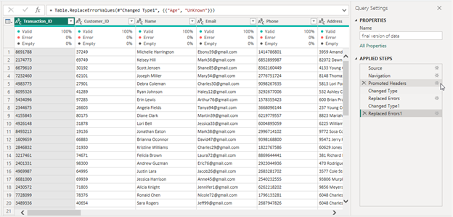

Slide 51
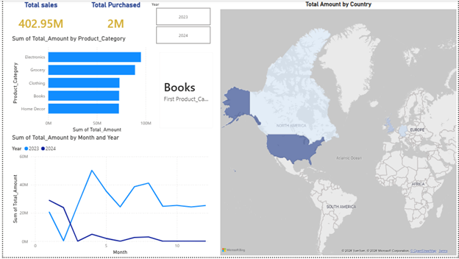

Slide 52
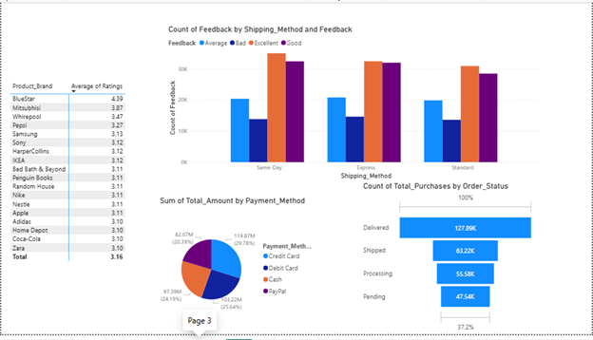

Slide 53
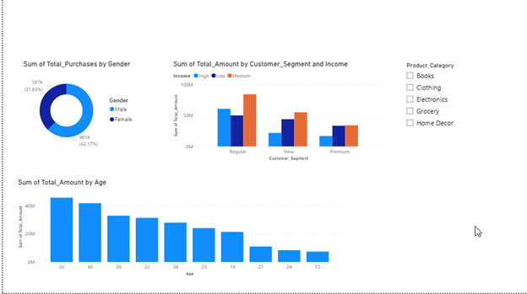

Slide 54
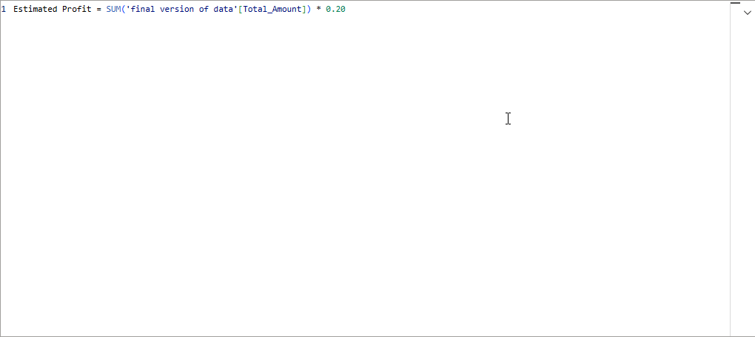

Slide 55
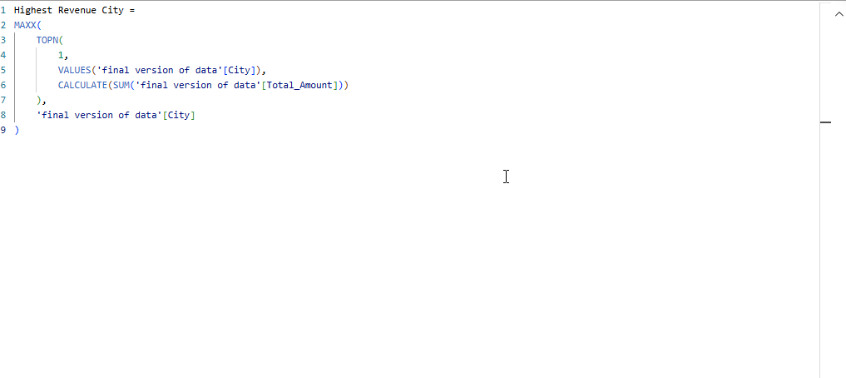

Slide 56
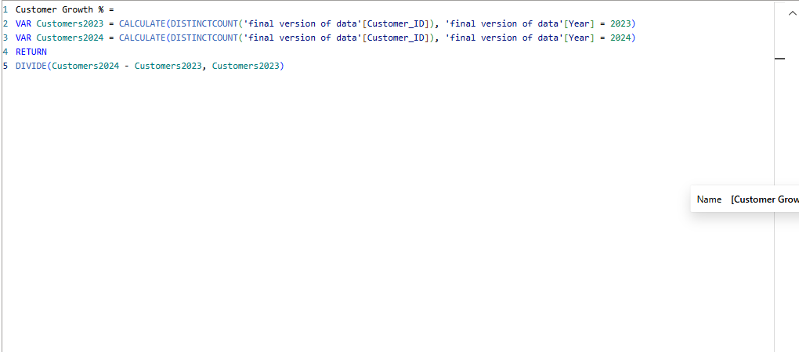

Slide 57
